Slide 1

Sentiment Analysis
Group 19
Yan Cui
Qishu Deng
Zhixuan Mai
Haoyu Shu
Luyuan Wang
Yu Xia
Zhiqing Xu
Notes:
XXXXX

Slide 2


BACKGROUND
Increasing popularity of sentiment analysis in
machine learning
Sentiment analysis is used to identify feelings from
texts
Sentiment analysis can help stake holders to make
vital decisions
Our report is intended to serve as a consulting
tool for the Ukrainian government and international
NGOs to analyze how Ukraine is perceived
internationally and provide valuable
recommendations to improve Ukraine’s
international presence and image.

Slide 3

AGENDA
Background
Factor and Topics Identification
Sentiment Modeling
Visualizations & Storytelling
Sentiment Classification
Conclusion & Recommendations

Slide 4

1
Sentiment Modeling

Slide 5

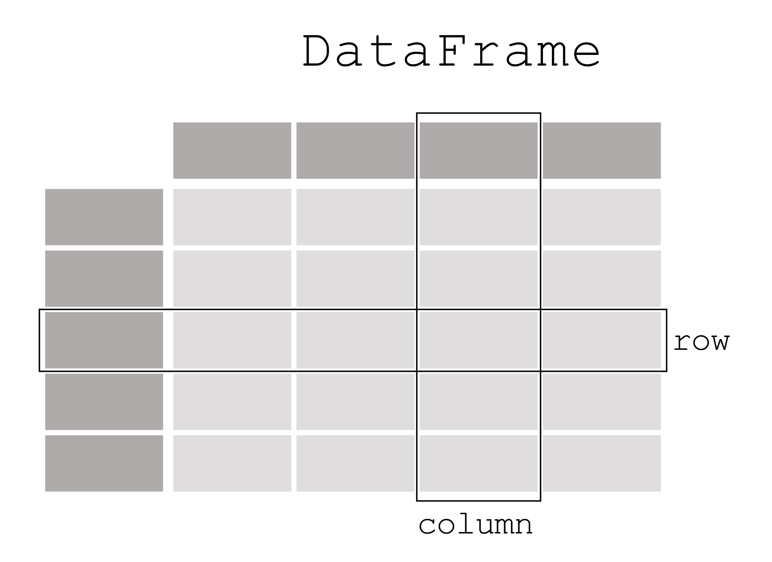








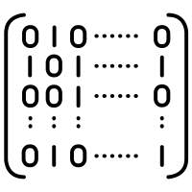
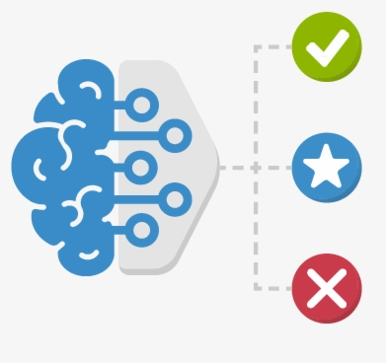

Data Cleaning and Processing
Remove Tags
Identify Language (spaCy)
Remove non-English Text
Remove Meaningless Comments
Drop Duplicates
“Happy Birthday!”
……
“Found a Transponder Snail! "I'll never forget you!!" Local cook sets sail!”
(Advertisement)
俄烏戰爭
Russian invasion of Ukraine War
Vectorization
Feature Selection
Machine Learning Models
(1) Term Frequency-Inverse
Document Frequency
(2) Bag-of-words
Chi 2 Feature Selection
Number of Features : 1000
(1) Logistic Regression
(2) Random Forest
(3) Naïve Bayes
(4) XGBoost Classifier
(5) MLP

Slide 6
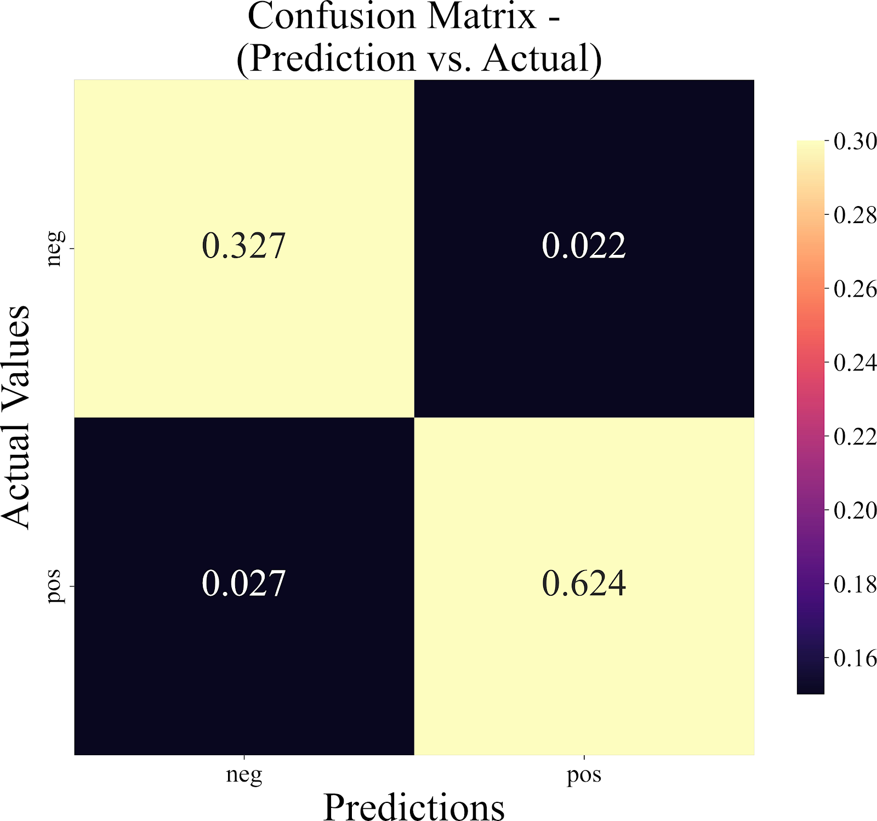
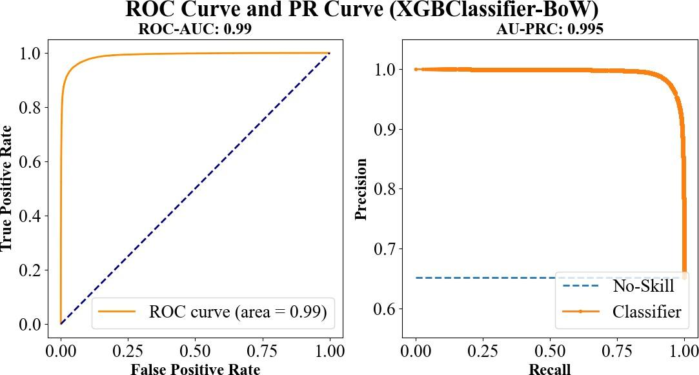
Grid Search For Hyperparameter Tuning
-- Grid Search result --
Logistic Regression Accuracy - TF-IDF: 0.9513, BoW: 0.9513
Naive Bayes Accuracy - TF-IDF: 0.9072, BoW: 0.9378
Decision Tree Accuracy - TF-IDF: 0.8011, BoW: 0.7872
XGBoost Accuracy - TF-IDF: 0.7552, BoW: 0.9512
MLP Accuracy - TF-IDF: 0.9672, BoW: 0.9663
Summary:
Among the Non-neural network approaches, LogisticRegression with TF_IDF has the best accuracy.
Grid Search has found best parameters for the model: {'C': 100, 'solver': 'liblinear’}.

Slide 7
2
Sentiment Analysis

Slide 8

Sentiment Analysis – Dataset and Models
Data source—Reddit
#1-reddit_raw_ukraine_russia
#2-russian_invasion_of_ukraine
Pretrained Models
VADER
DistilBERT-based Classifier
Model Comparisions
XGBoost
LogReg
MLP
Data Cleaning
dataset #1
raw dataset-16707 instances
cleaned dataset-15738 instances
dataset #2
raw dataset-200302 instances
cleaned dataset-186210 instances
Vader Prediction
generate label
positive
negative
neutral (respectively)
check labels distribution
adjust threshold settings
Best-performed: XGB
Performance:
Point-Biserial correlation coefficient: 0.303, p-value: 0.0
59.73% of the predictions are aligned with Vader Prediction

Slide 9
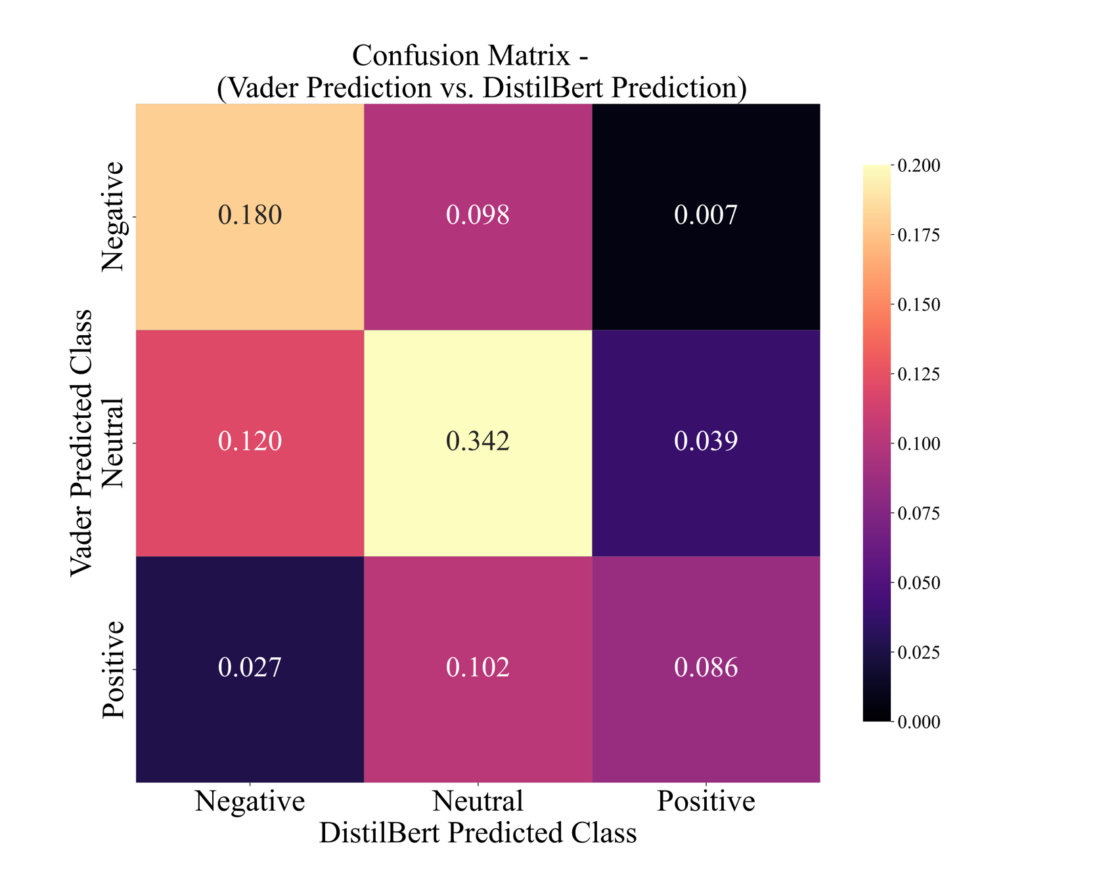
DistilBERT-based Sentiment Classifier
Data Cleaning
Based on BERT architecture
Threefold classifier (generate “positive”, “negative” and “neutral” labels)

Slide 10
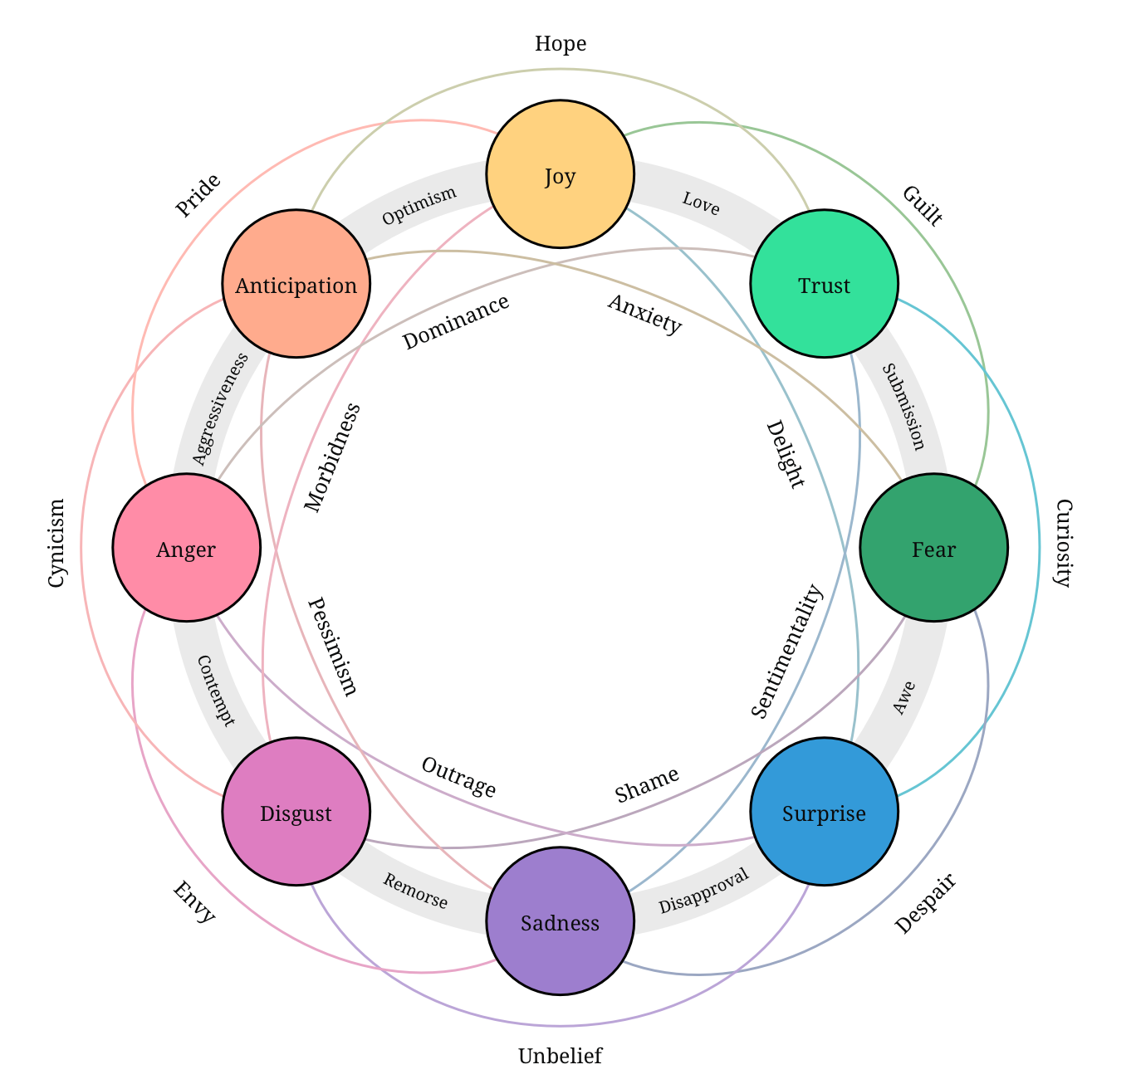
Emotions Detector
Multi-Label Classification Emotion Detector
Based on NVIDIA previous work “sentiment discovery”
Use the same dataset as NVIDIA research (~7,000 labeled data)
Improve the prediction with BERT-based models
Predict labels for 8 primary emotions + 3 extra labels.
Predict “optimism”, “pessimism” and “love” labels.

Slide 11
Factor and
Topics Identification
3

Slide 12
Factor and Topics Identification
BERTopic
BERTopic is a topic modeling technique used to identify the most prominent and meaningful topics in a given corpus of text data.
It utilizes the power of transformer-based language models such as BERT (Bidirectional Encoder Representations from Transformers) for superior performance in NLP tasks.
BERTopic uses a clustering approach to group similar documents together, making it more robust and less sensitive to outliers compared to traditional probabilistic models like LDA (Latent Dirichlet Allocation).
BERTopic is capable of handling large volumes of text data and identifying meaningful and interpretable topics without requiring labeled data.
It has been shown to outperform LDA in terms of accuracy and efficiency, making it a popular choice for researchers and practitioners in the field of natural language processing.

Slide 13
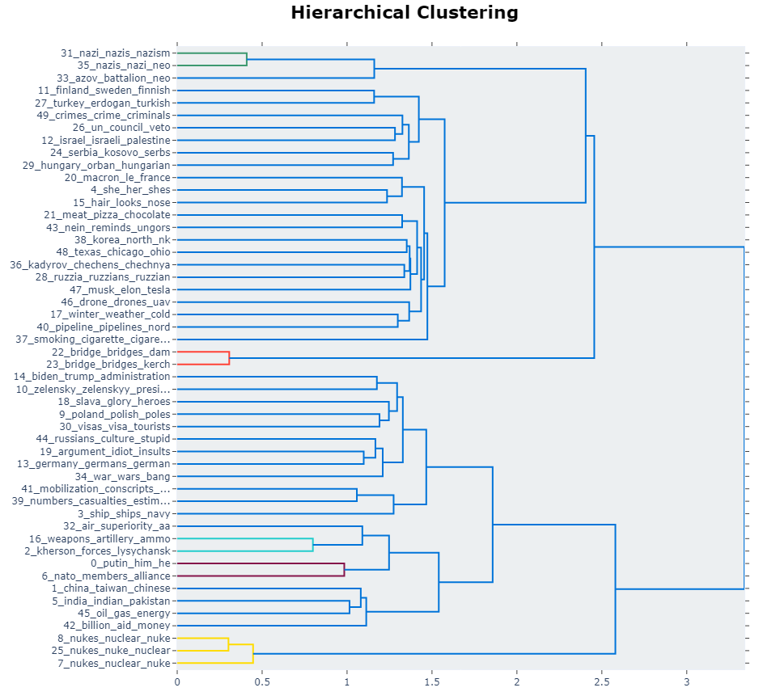
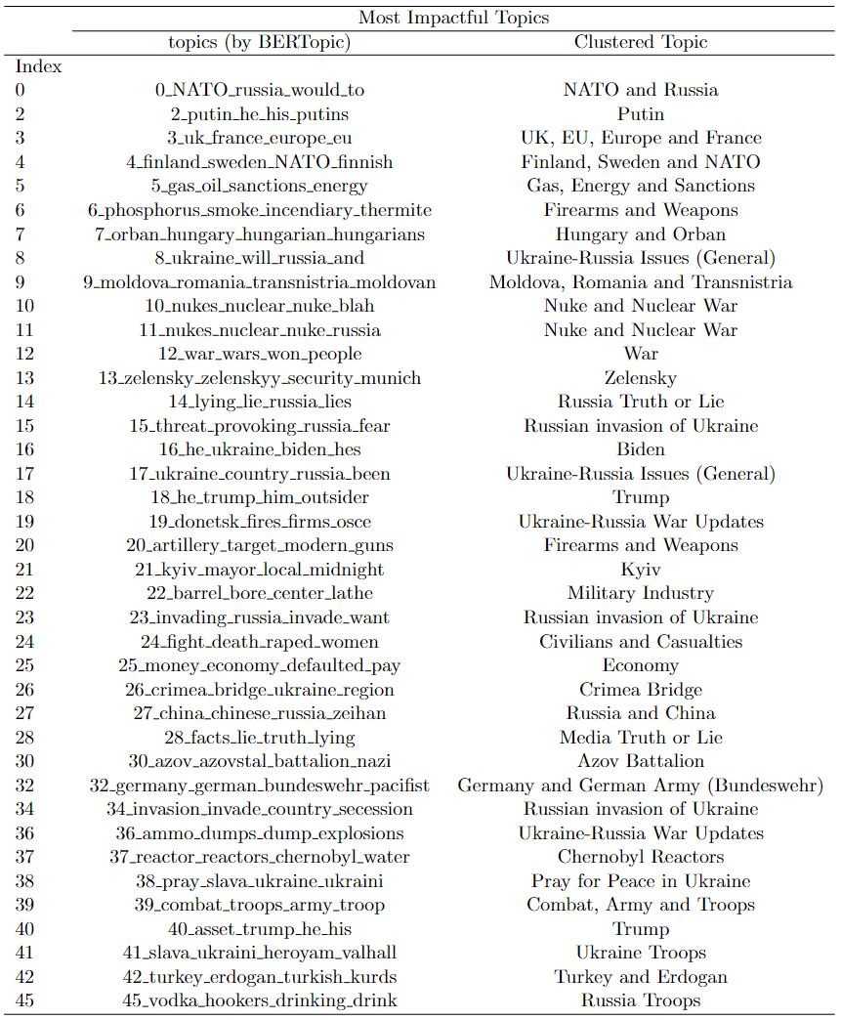
Topic Identification and Clustering

Slide 14

4
Visualizations & Storytelling

Slide 15
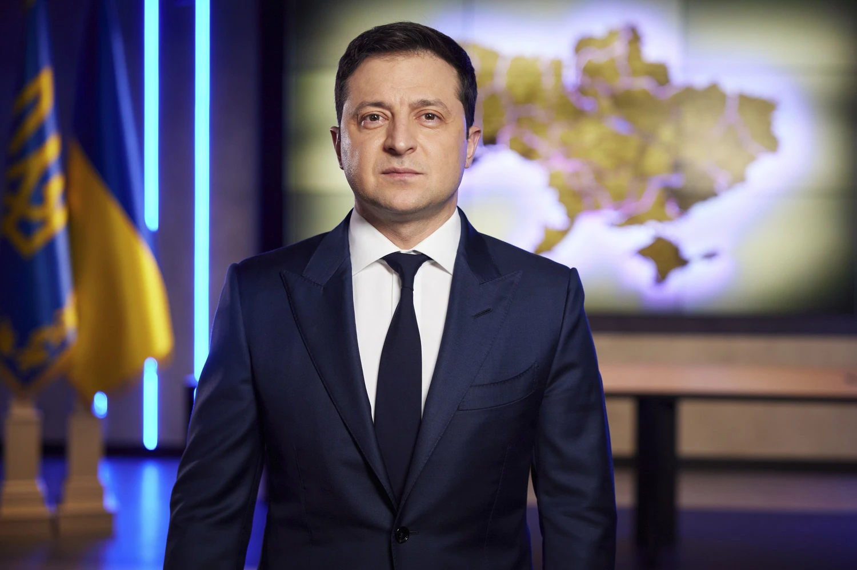
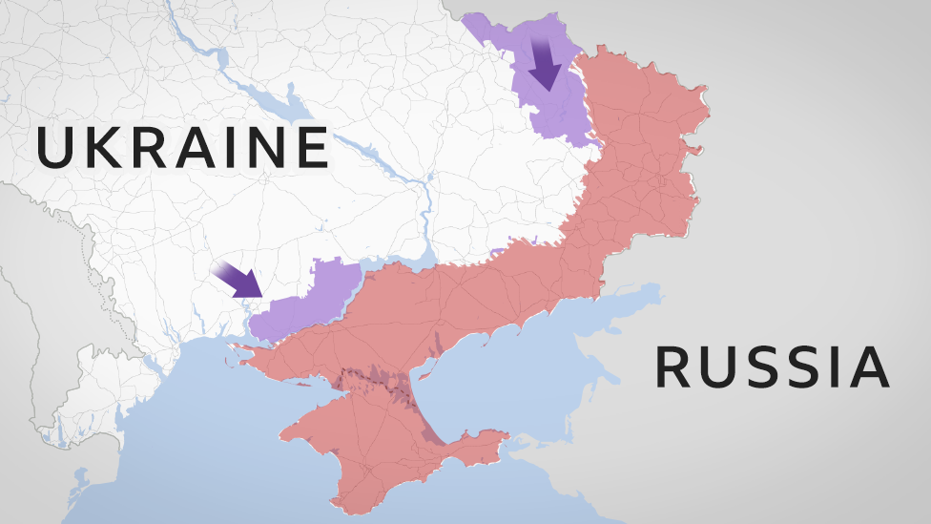
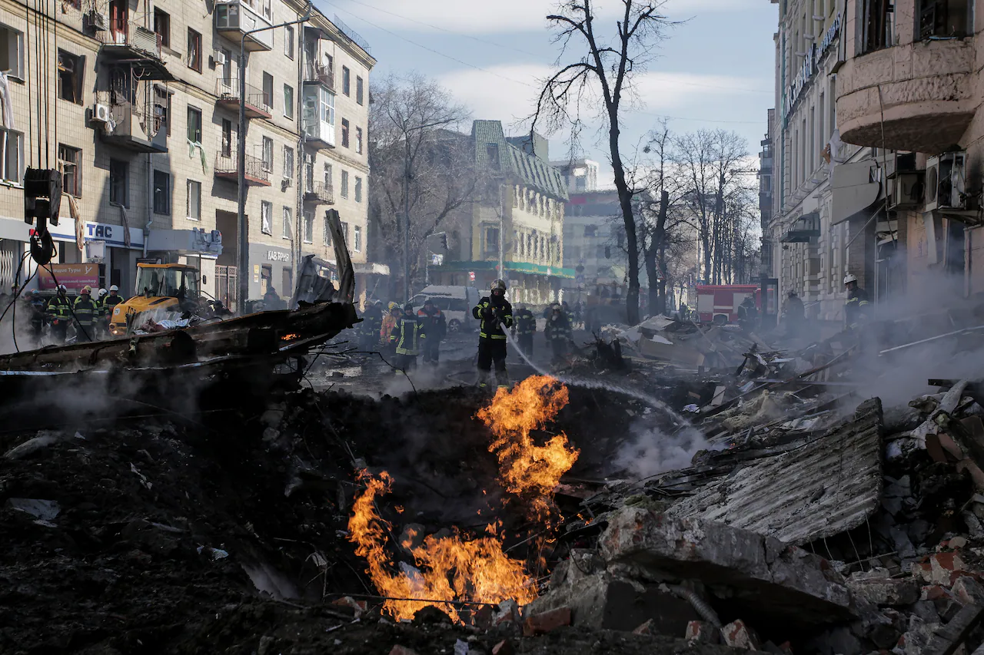

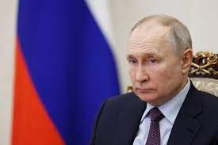
Topic Identified & Perception on Ukraine
zelensky_zelenskyy_our_munich
Topics and Sentiment
ukraine_russia_and_will
losses_casualties_ukrainian_numbers
nato_alliance_members_defensive
fault_responsibility_wouldnt_putins

Slide 16
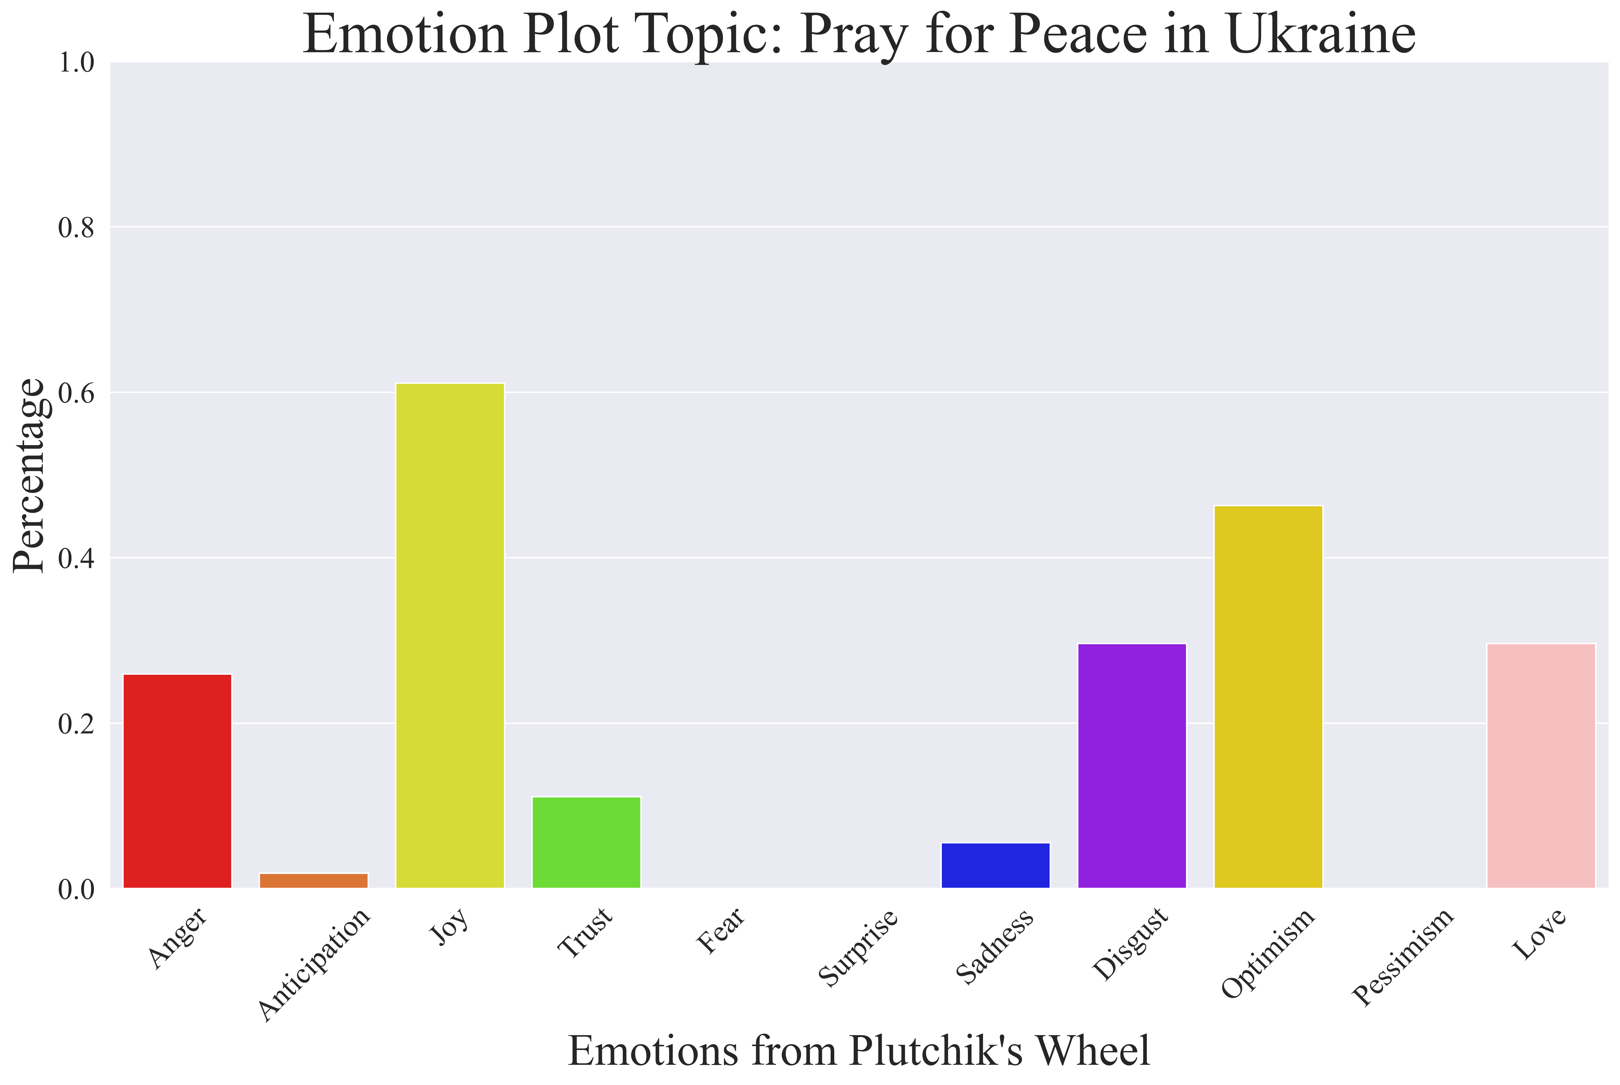
Pray for Ukraine

Slide 17
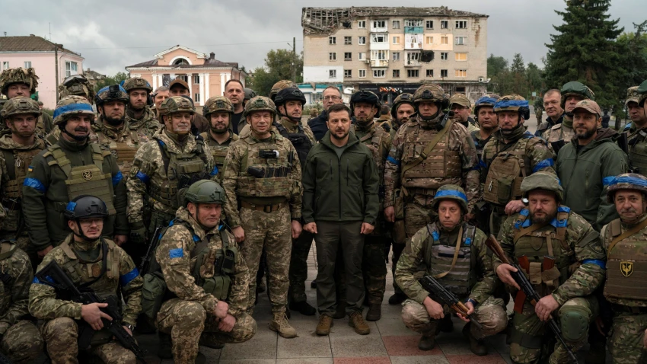
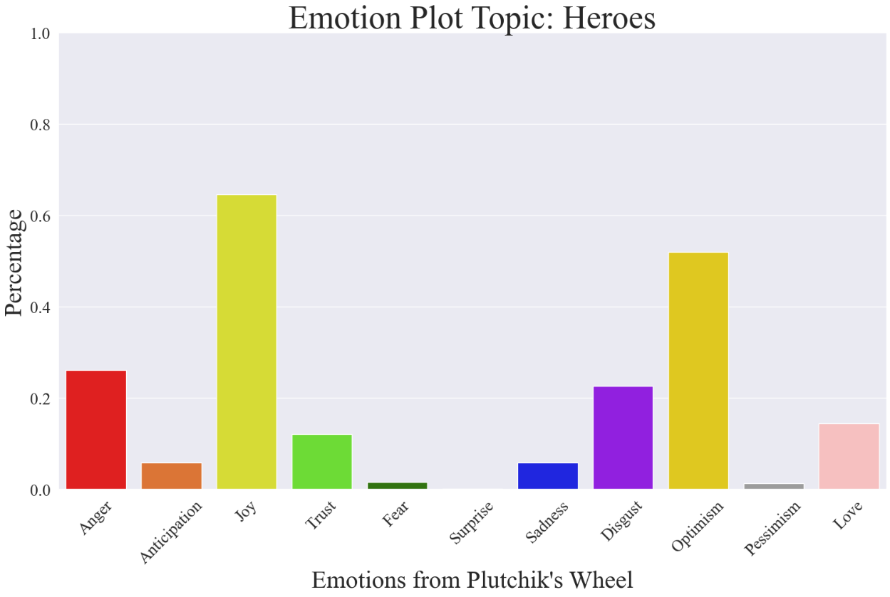
Ukrainian Heroes
Comment #320 : fodder for the Ukrainian heroes
Comment #858 : another one bites the dust , bravo Ukraine
Comment #944 : I am so impressed by the Ukrainian people standing together . What carries the soldiers fighting is the support of countless Ukrainians in the background doing their part .

Slide 18

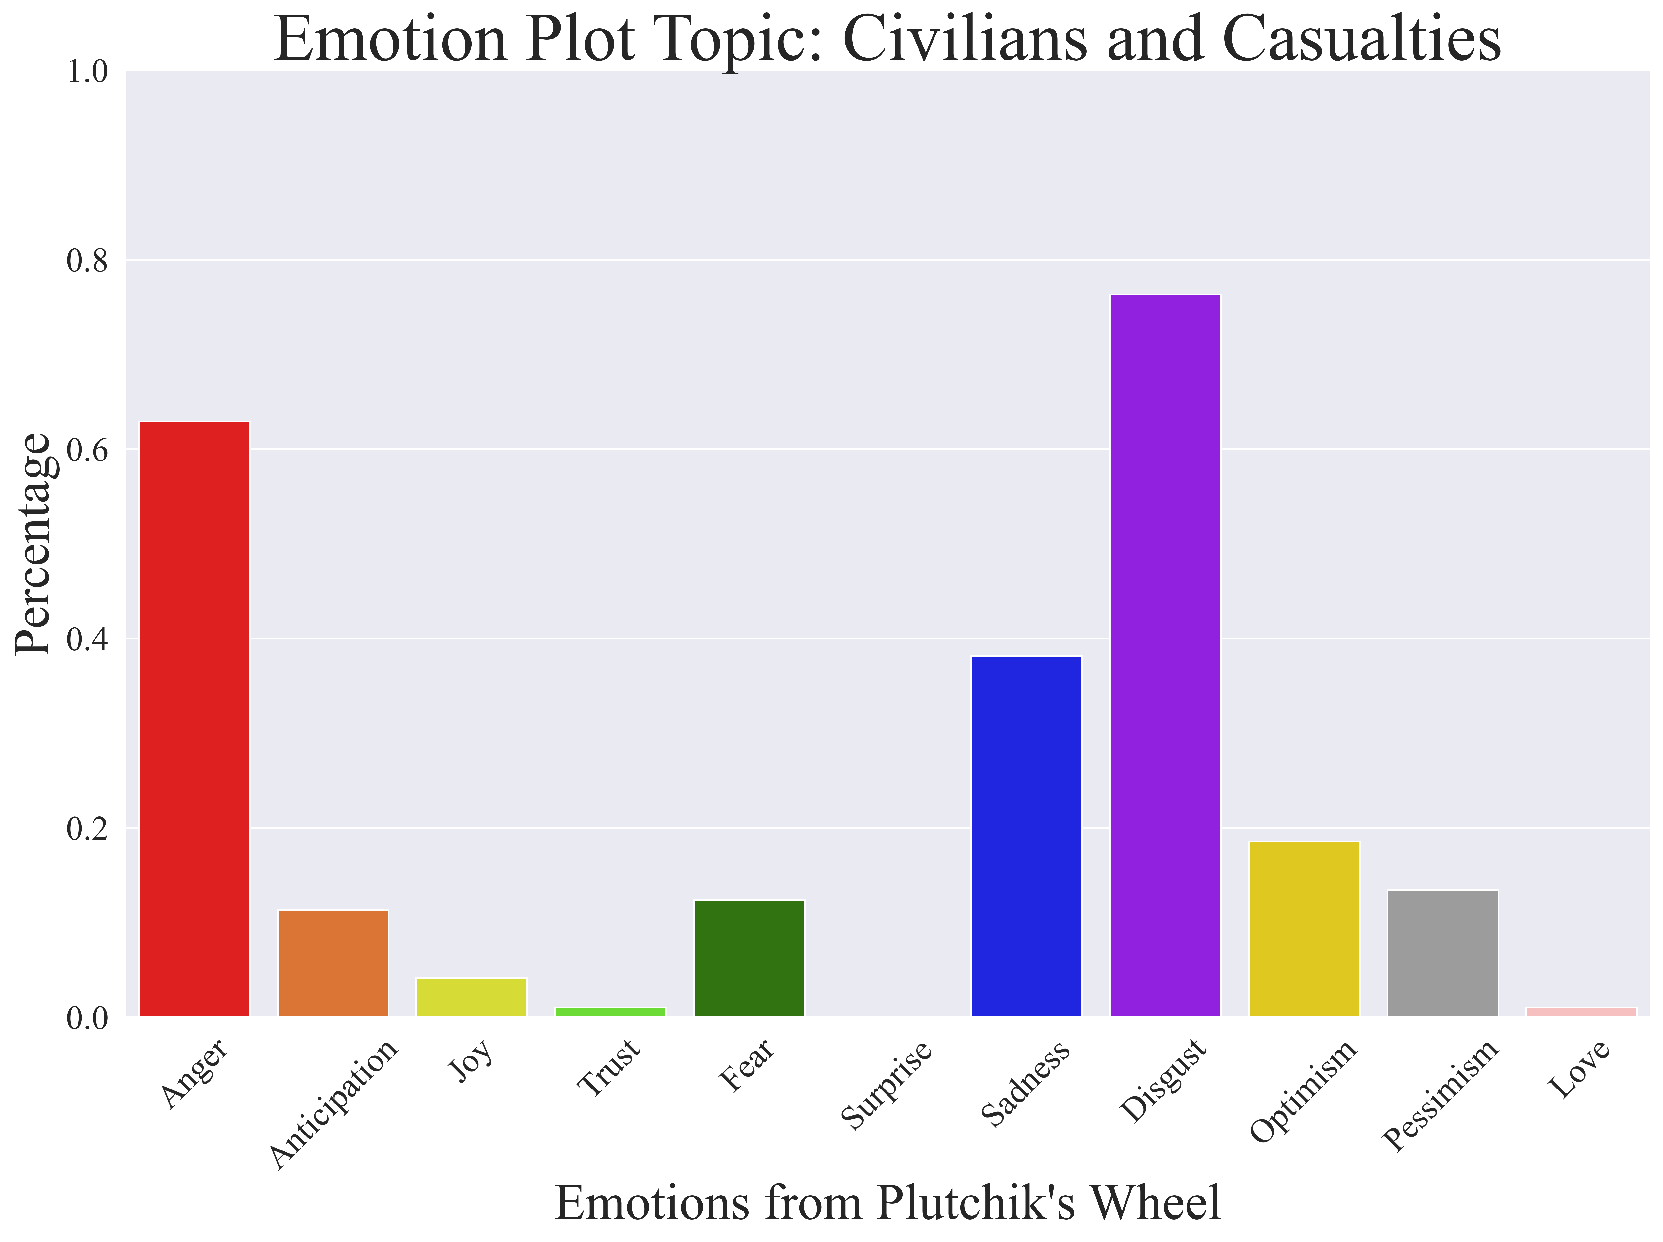
Civilians and Casualties

Slide 19

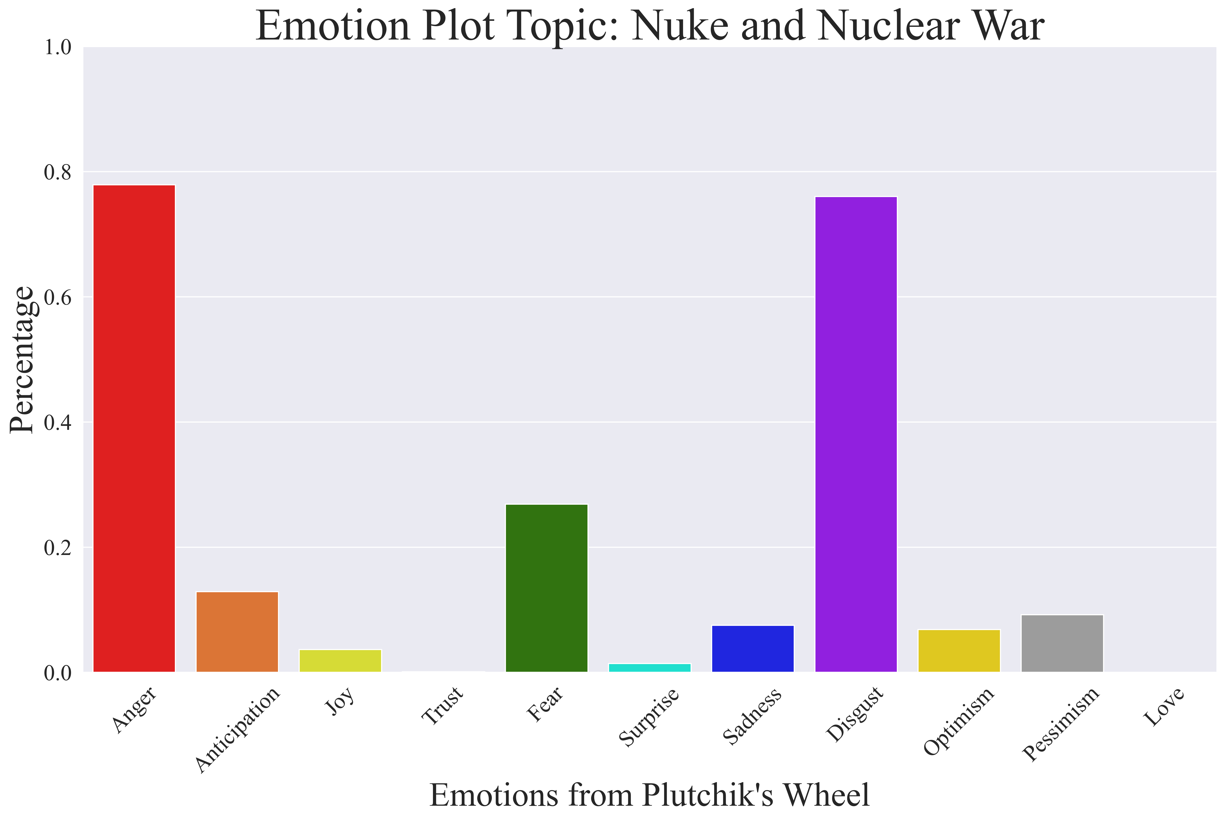
Global Nuclear Threats

Slide 20

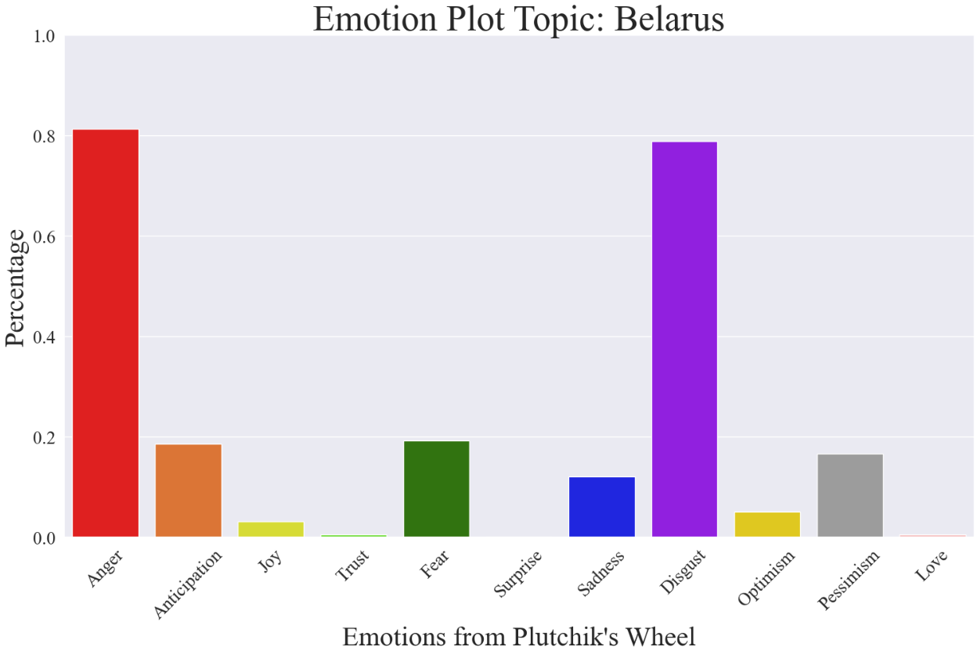
Behaviors of pro-Russian camp countries

Slide 21

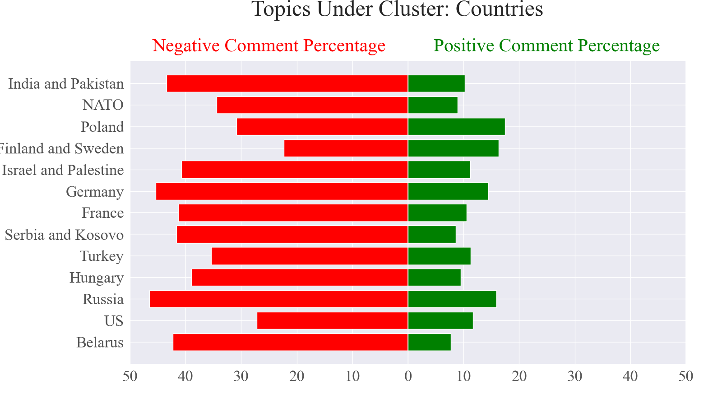
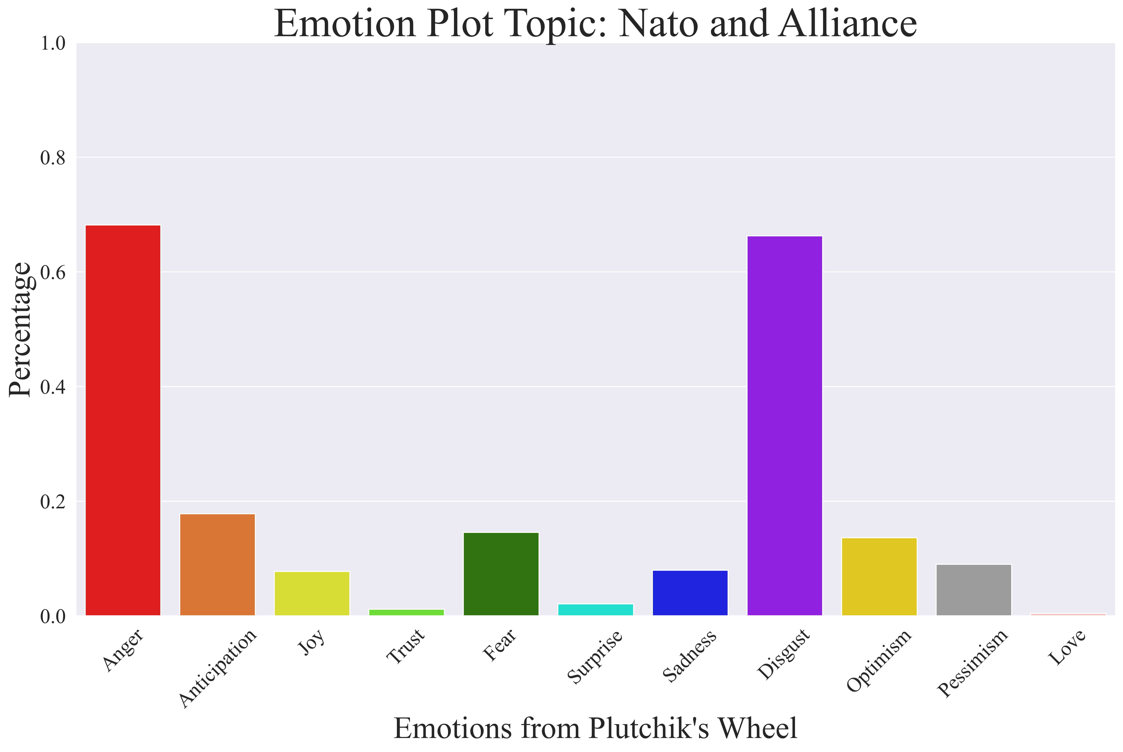
Countries and NATO Alliance

Slide 22
Conclusion & Recommendations
5

Slide 23

Conclusion
Voicing up on online resources like Reddit and Twitter is beneficial for Ukraine
Highlighting the human impact of the conflict and emphasizing the broader geopolitical implications
allows individuals to participate in helping Ukraine
Aiding Ukraine in upholding principles of democracy and sovereignty is a process of united efforts.

Slide 24

Recommendations
Enhance economic development
Strengthen cultural diplomacy
Focus on humanitarian aid and support the victims of the conflict
Highlight the resilience and bravery of the Ukrainian people
Negotiations
Voicing up on online resources like Reddit and Twitter

Slide 25
Reference
Neel Kant, Raul Puri, Nikolai Yakovenko, and Bryan Catanzaro. Practical text classification with large pre-trained language models. CoRR, abs/1812.01207, 2018. URL http://arxiv.org/abs/1812.01207.
Yinhan Liu, Myle Ott, Naman Goyal, Jingfei Du, Mandar Joshi, Danqi Chen, Omer Levy, Mike Lewis, Luke Zettle- moyer, and Veselin Stoyanov. Roberta: A robustly optimized BERT pretraining approach. CoRR, abs/1907.11692, 2019. URL http://arxiv.org/abs/1907.11692.
Saif M. Mohammad, Felipe Bravo-Marquez, Mohammad Salameh, and Svetlana Kiritchenko. Semeval-2018 Task 1: Affect in tweets. In Proceedings of International Workshop on Semantic Evaluation (SemEval-2018), New Orleans, LA, USA, 2018.
Victor Sanh, Lysandre Debut, Julien Chaumond, and Thomas Wolf. Distilbert, a distilled version of BERT: smaller, faster, cheaper and lighter. CoRR, abs/1910.01108, 2019. URL http://arxiv.org/abs/1910.01108.

Slide 26


Thank you
& QA

